Slide 1

Summer training at Geeks for Geeks
Data structures and algorithms(self placed)
Name : Ravi
Registration No.: 11801369

Slide 2

TABLE OF CONTENTS
INTRODUCTION
TECHNOLOGY LEARNT
REASON FOR CHOOSING DSA
LEARNING OUTCOMES
REAL LIFE APPLICATION
CERTIFICATE
CONCLUSION

Slide 3
INTRODUCTION
DSA self paced course is a complete package that helped me to learn Data Structures and Algorithms from Basic to an Advance level. The course curriculum has been divided into 8 weeks, where I practiced questions and I have attempted the assessment tests accordingly. The course offers a wealth of programming challenges that helped me to learn all about DSA and making of an algorithm and how to solve problems and the logic behind the Algorithm.
The course was Self placed means I could join the course anytime and all the content will be available to me once I get enrolled. There were video lectures to learn form and multiple choice questions and problems to practice.

Slide 4
TECHNOLOGY LEARNT
Course consists of 24 units which I divided them into 6 week planner

Slide 5
Week 1
Introduction to DSA
Mathematics
Bit magic
Recursion

Slide 6
Week 2
Array
Searching
Sorting
Matrix

Slide 7
Week 3 and 4
Hashing
String
Linked list
Stack
Queue
Deque
Tree
Binary Search tree

Slide 8
Week 5 and 6
Heap
Graph
Greedy
Backtracking
Dynamic Programming
Trie
Segment and Binary Indexed Tree
Disjoint Set

Slide 9

Reasons For Choosing DSA
My Interest
Importance of DSA
Need of learning Algorithms
Number of Problems
Content Quality
Course Track
Real life Applications

Slide 10
Learning Outcomes
DSA from Basics to Advanced
Topic wise implementation
Improved problem solving skills
Developed analytical skills
Product based companies problems

Slide 11
Real Life Applications
Searching in documents
Location on google maps
Image Processing
Music Player
Undo Operation
Speech Signals

Slide 12
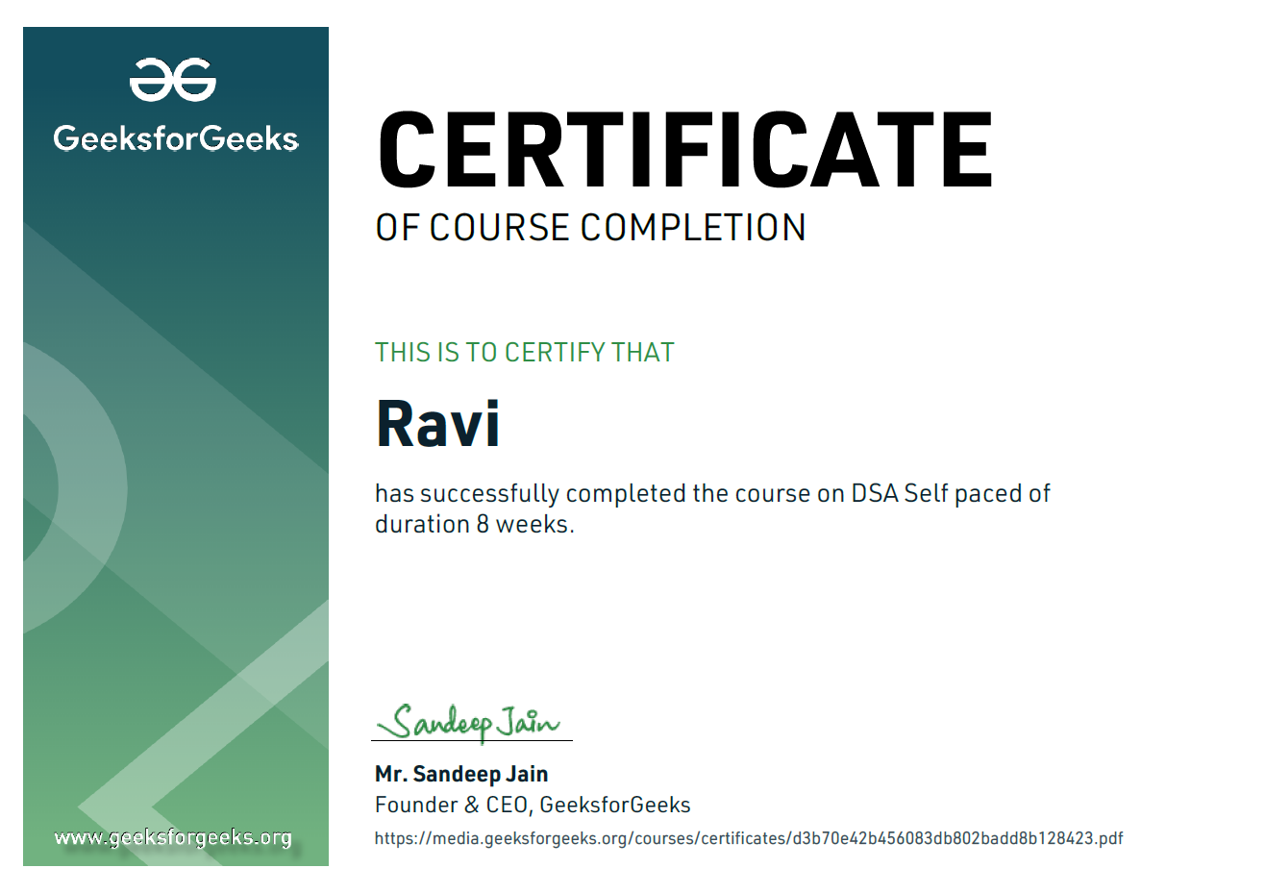
GEEKS FOR GEEKS CERTIFICATE OF DSA

Slide 13
CONCLUSION
Learnt data structures and algorithms in deep
Improved my problem solving skills
Useful for placements
Useful for real life applications
Better understanding of problems

Slide 14
THANK YOU
Data structure and algorithms help in understanding the nature of the problem at a deeper level and thereby a better understanding of the world.

